Slide 1
Game Design and Programming
Neil Gannon

Slide 2
Today
Pausing the Game
Physics Joints
Distance Joint
Fixed Joint
Hinge Joint
Spring Joint
Wheel Joint
Lighting
Point, Spot, Directional
Materials

Slide 3
Time Scale

Slide 4
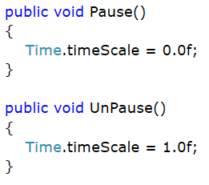
Time Scale/Pausing
In Unity the rate at which time passes is controller through the Time.timeScale property
Commonly known as time dilation
By default this value is one
The game will run 60FPS/16ms
Set this value to zero to effectively pause the game
When timescale is set to zero
The UI system still works as normal
Any code that uses Time.deltaTime will not function as expected

Slide 5
Joints

Slide 6
Joints
Unity features a range of physics constraints know as joints
These joints allow us to achieve a specific set behaviours from rigid bodies
No need for C# to implement restrictions on how a body behaves
can still be done in C# if desired
Typically we attach rigid bodies together using joints
The key Physics Joints we will examine are
Distance Joint
Fixed Joint
Hinge Joint
Spring Joint
Wheel Joint

Slide 7
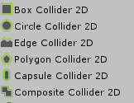
RigidBodies and Colliders
In Unity a collider defines the physical shape of an object
The shape is used when determining if two objects collide and how they are to be separated
By default objects use a transform component to move, scale, rotate
A RigidBody places an object under control of the physics simulation
All translations (movements) are applied through the rigid body
These movements are then relayed back to the transform component and the collider
RigidBodies do not provide any collision detection

Slide 8
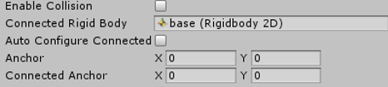
Common Joint Features
Most joints in Unity have a common set of features
Do you want the object to react as normal to collisions?
What is this rigid body connected to
Another rigid body?
A point in space relative to the joint?
The anchors define the point around which the joint is constrained
If attached to another rigid body this will be automatically filled in
Fell free to modify

Slide 9
Distance Joint

Slide 10
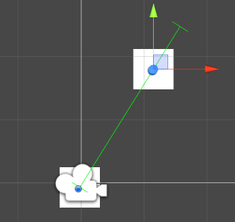
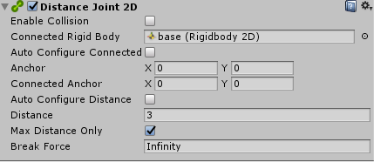
Distance Joint
Attaches two objects together
Keeps these objects at set distance from each other
Can be a min and max distance (default)
Just the max distance
In the sample on Moodle the joint is configured to never go beyond a maximum distance
Distance is indicated by a green horizontal line
Can use used to create a swing

Slide 11
Fixed Joint

Slide 12
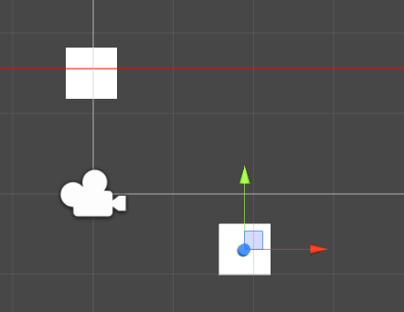
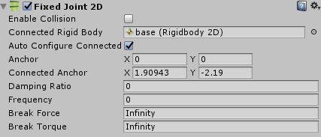
Fixed Joint
Keeps two objects at a fixed distance and angle from each other
These objects cannot
Move away from each other
Get closer to each other
If one of these object is rotated the other will have this applied
Use the relative joint to achieve this

Slide 13
Hinge Joint

Slide 14
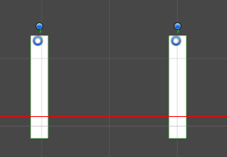
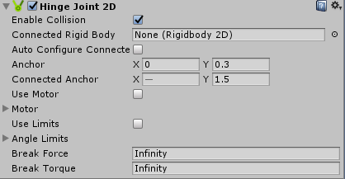
Hinge Joint
A hinge joint allows an object to be rotated around a point in space
The position of the anchors is very important for this joint
Note the doors on the right
The anchors are set at the very edge of the door
This the point on which the door will rotate around
Hinges feature a motor which allow them to powered
Move themselves
Angle limits can be applied to hinges to restrict their rotation

Slide 15
Spring Joint

Slide 16
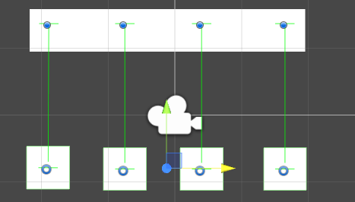
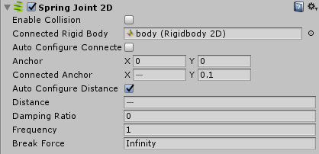
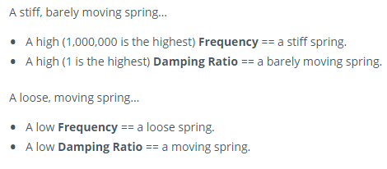
Spring Joint
Similar idea to the distance joint but with spring effect when the object get close to each other
Frequency
A value between 0 and 1,000,000
Controls the stiffness of the spring
The higher the value to stiffer the spring
Damping ratio
A value between 0 and 1
Controls the oscillation of the spring (movement)

Slide 17
Wheel Joint

Slide 18
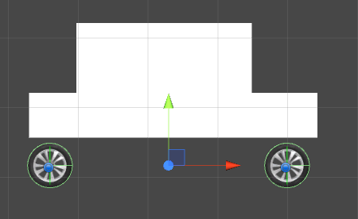
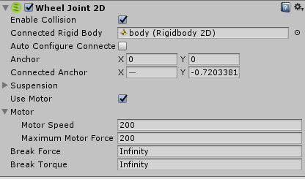
Wheel Joint
Allows us to simulate a rotating wheel
Can be used to create vehicles (among other things)
The anchor points are important here
The point which the will rotate around
Motors are important here
Allows the object to move itself
Suspension uses a spring to control the distance between the joint and the connected rigid body

Slide 19
Lighting

Slide 20
Lights
Unity has range of built in lights
Point Light
Directional Light
Spot Light
Unity by default does not provide 2D lighting
Requires us to override some sprite properties to get working
Some types of lights are not effective in 2D
Due to the small world size of 2D games there can be side effects when using too many lights

Slide 21
Point Light

Slide 22
Point Light
A point light is a light source when shines equally in all directions
A single point in space that emits energy in a uniform spherical field
The amount of power that reaches an object depends on the distance between the object and the light source
We can position it but we cannot control the direction in which it shines
The centre of the spherical field of energy
Unlike the directional lights which we cannot position but can control the direction

Slide 23
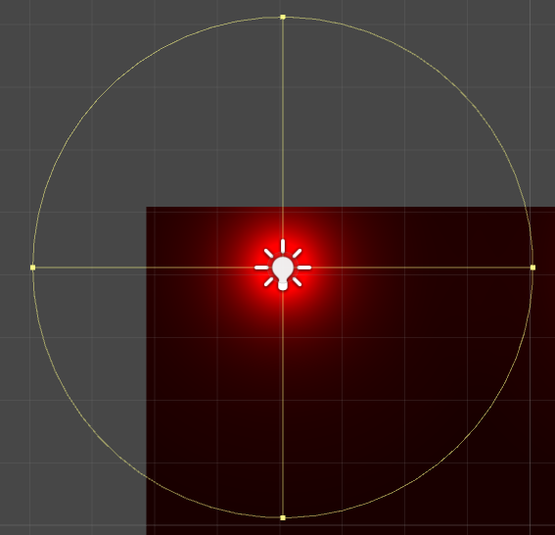
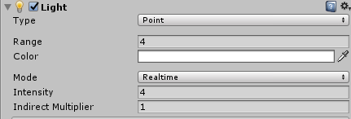
Point Light
Range
Commonly known as the attenuation radius of the light
Area of influence
As we move away from the center of the light the intensity weakens
Color
Light color
The final color of surface will be it’s diffuse * light color
Intensity
How bright the light is

Slide 24
Attenuation
Attenuation is the process where something is weakened
The intensity weakens with the inverse square of the distance
Every time an object doubles its distance it receives a quarter of the energy
Note that while this is mathematically correct
We do not account for the matter which our light passes though
Light intensity does attenuate when passing through matter in the real world
Traditionally not implemented in game engines due to being computationally expensive
Starting to change as hardware becomes more powerful (Unreal Engine 4)
In the real world an attenuations value will never be zero
A surface will always receive a small value of light

Slide 25
Spot Light

Slide 26
Spot Light
A spotlight is similar to a point light
Light leaves in all directions from the source
An occluder blocks light from leaving in all but one direction
Giving the spot light more directional control over the point light
The light that leaves is in the shape of a cone
Changing the position of the light will change the angle of the cone
Light Source
Cone Angle
Light Direction

Slide 27
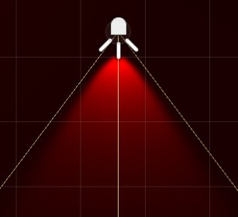
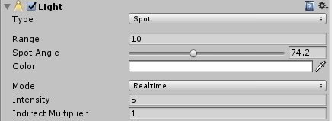
Spotlight
Spot Angle
How wide of cone is on the spot light
Measured in euler angles

Slide 28
Directional Light

Slide 29
Directional Light
Directional lights are special form of point light
As an object moves further away from a light source the angle of the rays become closer to parallel
By removing the attenuation of a light source we can create a infinite point light
Sunlight
There is a trade off between using a directional light and point light
Directional lights are cheaper to calculate but don’t look as good
Point lights are more expensive to calculate but look better
Directional lights are a good choice for replicating sunlight

Slide 30
Materials

Slide 31
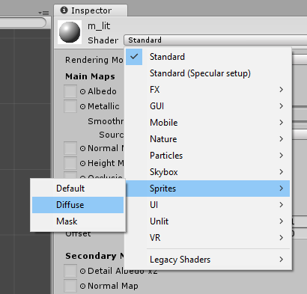
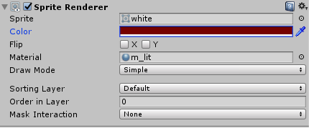
Lit Material
By default all sprites in Unity use an Unlit material
All sprites are whatever color is in the image
No difference between your imaging program and Unity
Cannot be lit by lights
We want a material that interacts with light in in our scene
Creating a new diffuse material allows our sprite to influenced by lights
Final Color
Image Color * Sprite Color * Light Color

Slide 32
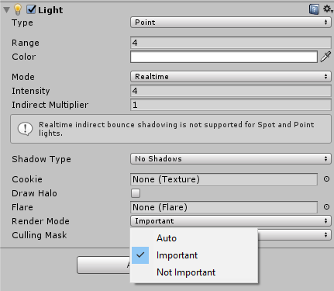
Render Mode
In 3D applications we can calculate lighting using two methods
Vertex Lighting
Pixel Lighting
Pixel lighting is the only option that will work in 2D games
Unity by default tries to prioritise which lights should be calculated
We will override this by setting all lights Render Mode to Important
This stops lights from being disabled when too many are added
More lights = Bigger performance demands

Slide 33
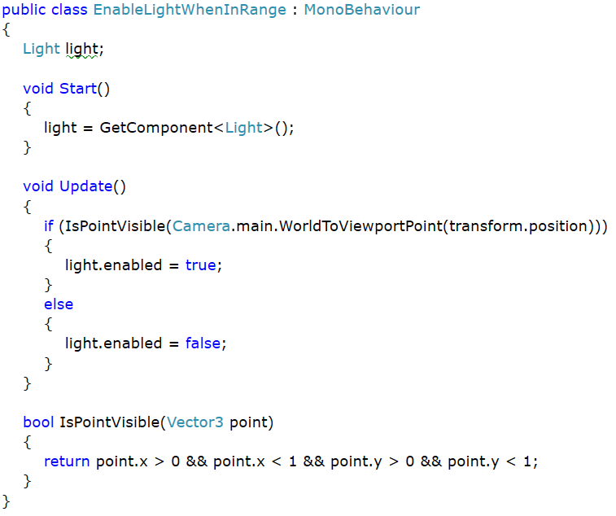
Toggle Light when Visible
A script which disables lights that not currently visible on the screen
Takes the position of each light
Converts it to 2D viewport point
A value that is > 0 && < 1 means the light is on the screen
Reduces performance impact of having all lights set to important

Slide 34
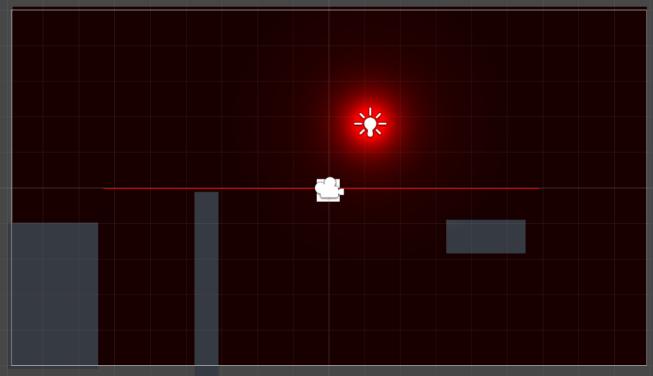

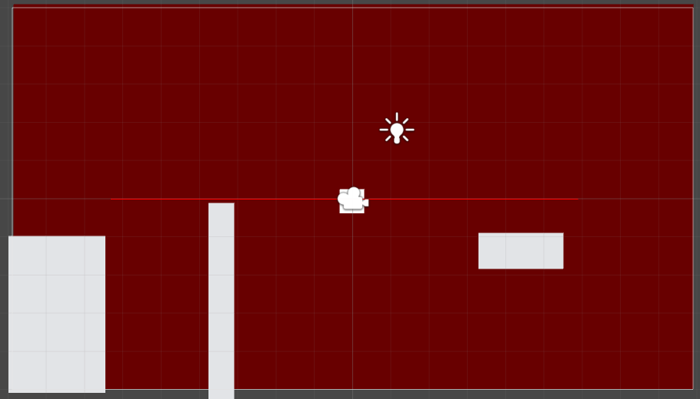
Disabling for Design
Can be difficult to design a scene with lighting enabled
To make this easier you can disable lighting when making your level
Light icon at the top of the scene window

